Slide 1
Chapter - 6
Constructors and Destructors

Slide 2
Key Concepts
• Constructing objects
• Constructors
• Constructor overloading
• Default argument constructor
• Copy constructor
• Constructing matrix objects
• Automatic initialization
• Parameterized constructors
• Default constructors
• Dynamic initialization
• Dynamic constructor
• Destructors

Slide 3
6.1 Introduction
Member functions such as putdata() and setdata() provide initial values to private member variables.
Example:
A.input() assigns values to data members.
Example:
x.getdata(100, 299.95) passes initial values as arguments to set data in objects.
These functions cannot initialize member variables at object creation.

Slide 4
Philosophy of C++ Initialization
C++ allows user-defined data types (classes) similar to built-in types.
A class type variable should be initialized when declared, like built-in types.
Example: int m = 20; float x = 5.75;
Destructor automatically deletes objects after scope ends.
Special member functions:
Constructor: Initializes objects at creation.
Destructor: Destroys objects when no longer required.

Slide 5
6.2 Constructors
• A constructor is a special member function used to initialize objects of its class.
• It has the same name as the class.
• Automatically invoked when an object of the class is created.
• Called constructor because it constructs the values of data members.
Example:
class integer {
int m, n;
public:
integer(void); // constructor declared
};
integer::integer(void) { // constructor defined
m = 0; n = 0;
}

Slide 6
Default Constructor
• When a class contains a constructor, any object created will be initialized
automatically.
Example:
integer int1; // object int1 created
• This initializes data members (m, n) to zero without explicit function call.
• A constructor with no parameters is called the default constructor.
• Default constructor for class A is A::A().
• If no constructor is defined, the compiler supplies a default constructor.
• Example:
A a; // invokes default constructor to create object a.

Slide 7
Characteristics of Constructors
• Declared in the public section of a class.
• Invoked automatically when objects are created.
• Do not have return types, not even void.
• Cannot be inherited (though derived class can call base class constructor).
• Can have default arguments.
• Constructors cannot be virtual.
• Cannot refer to their addresses.
• Object with constructor/destructor cannot be a union member.
• Implicitly call operators new and delete for memory allocation.
Note: Declaring a constructor makes object initialization mandatory.

Slide 8
6.3 Parameterized Constructors
A constructor initializes data members of objects.
Default constructor initializes all data members to zero.
In practice, objects may need different initial values.
C++ allows passing arguments to constructors.
This enables initialization of objects with different values.
Such constructors are called parameterized constructors.

Slide 9
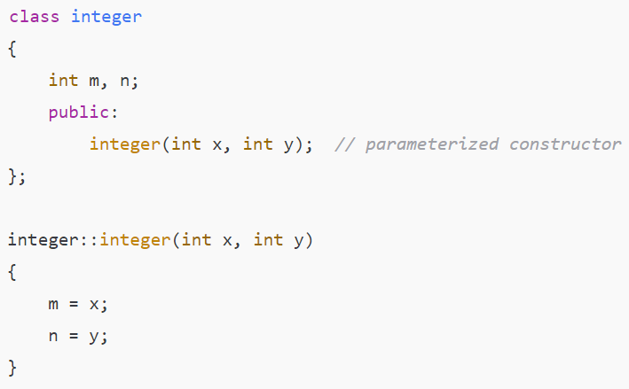
Example

Slide 10
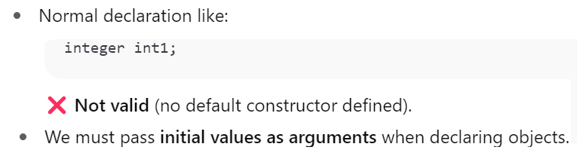
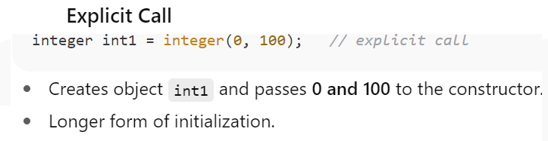
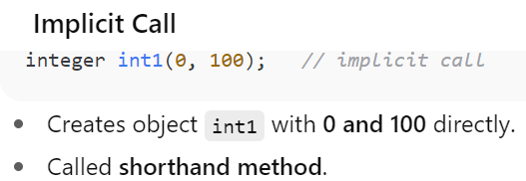
Object Creation with Parameterized Constructors

Slide 11

Continue…

Slide 12
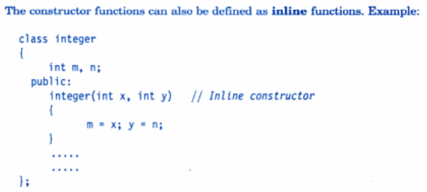
Continue…

Slide 13
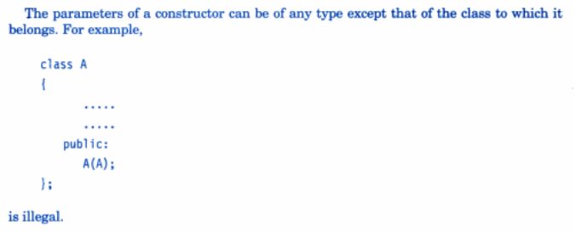
Continue…

Slide 14
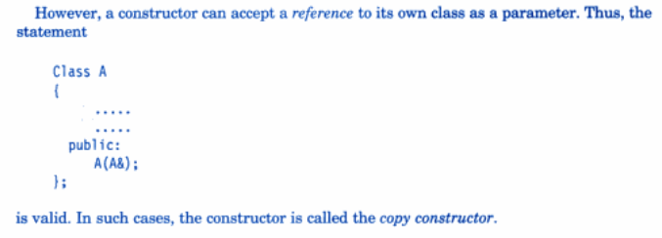
Continue…

Slide 15
6.4 Multiple Constructors in a Class
• Constructors are special functions used for object initialization.
• A class can have multiple constructors with different argument lists.
• This is called Constructor Overloading.

Slide 16
Types of Constructors
1. Constructor with no arguments.
2. Constructor with two integer arguments.
3. Constructor with one object as argument (Copy Constructor).

Slide 17
Example: Class integer
class integer {
int m, n;
public:
integer() {m=0; n=0;} // Constructor 1
integer(int a, int b) {m=a; n=b;} // Constructor 2
integer(integer &i) {m=i.m; n=i.n;} // Constructor 3
};

Slide 18
Usage Examples
• integer I1; // Calls constructor 1 (m=0, n=0)
• integer I2(20,40); // Calls constructor 2 (m=20, n=40)
• integer I3(I2); // Calls constructor 3 (copy constructor)

Slide 19
Key Points
• Constructor overloading allows multiple constructors in the same
class.
• The compiler chooses the constructor based on the arguments.
• Copy constructor is used to create a new object as a copy of an
existing one.

Slide 20
6.5 Constructors with Default Arguments
• Constructors can have default arguments.
• Default values are used when arguments are not provided.
• Helps simplify object initialization.

Slide 21
Example Declaration
complex(float real, float imag = 0);
• The default value of 'imag' is 0.
• If only 'real' is provided, 'imag' is automatically set to 0.

Slide 22
Example Usage
complex C(5.0);
→ real = 5.0, imag = 0.0 (default)
complex C(2.0, 3.0);
→ real = 2.0, imag = 3.0 (explicit values)

Slide 23
Key Rule
• Default arguments must be trailing (from right to left).
• Missing arguments are replaced by their default values.

Slide 24
Default Constructor vs Default Argument Constructor
• Default Constructor: A::A()
• Default Argument Constructor: A::A(int = 0)
Ambiguity arises when both are defined in the same class:
A a; // Compiler confusion: call A::A() or A::A(int=0)?

Slide 25
6.6 Dynamic Initialization of Objects
• Class objects can be initialized dynamically.
• Initial value of an object may be provided during run time.
• Advantage: Provides various initialization formats using overloaded
constructors.
• Flexibility: Different formats of data can be used at run time
depending on the situation.

Slide 26
Example Context
• Consider long term deposit schemes in commercial banks.
• Banks provide different interest rates for different schemes.
• Rates vary for different periods of investment.
• Program 6.3 illustrates the use of class variables for account details.

Slide 27
Dynamic Initialization in Practice
• Class variables can hold account details.
• Constructors dynamically initialize variables during run time.
• Flexibility for different schemes and investment durations.
• Demonstrates practical use of object-oriented programming in
banking applications.

Slide 28
6.7 Copy Constructor
• Copy constructor is used to declare and initialize an object from
another object.
• Syntax: integer(integer &i);
• It is one of the overloaded constructors.
• Provides a way to duplicate objects during creation.

Slide 29
Example of Copy Constructor
• Example statement:
integer I2(I1);
• This defines the object I2 and initializes it to the values of I1.
• Another form:
integer I2 = I1;

Slide 30
Copy Initialization
• The process of initializing through a copy constructor is called copy
initialization.
• Example:
I2 = I1;
• Ensures new object is initialized with values of an existing object.

Slide 31
Assignment vs Copy Constructor
• Statement I2 = I1 does not invoke the copy constructor.
• Instead, it assigns values of I1 to I2, member-by-member.
• This is handled by the overloaded assignment operator (=).
• Copy constructor is invoked only when a new object is created from an existing object.

Slide 32
Copy Constructor Argument
• A copy constructor takes a reference to an object of the same class.
• Syntax example:
ClassName(const ClassName &obj);
• Ensures that an object can be initialized from another object of the
same class.

Slide 33
Example Preview
• Program demonstrates constructing and using a copy constructor.
• Shows how objects are copied safely.
• Important for managing resources and avoiding shallow copies.

Slide 34
6.8 Dynamic Constructors
• Constructors can be used to allocate memory while creating objects.
• Ensures the system allocates the right amount of memory for each object.
• Useful when objects are not of the same size, saving memory.

Slide 35
Dynamic Construction of Objects
• Allocation of memory to objects at the time of their construction.
• Known as dynamic construction of objects.
• Memory is allocated using the 'new' operator.

Slide 36
6.9 Constructing Two Dimensional Arrays
Only program

Slide 37
6.10 const Objects
We may create and use constant objects using the const keyword before object declaration.
Eg:
const matrix X(m,n); // object X is constant
Any attempt made to modify the values of m and n will generate compile-time error.
A const object can only call const member functions
Whenever const objects try to invoke non-const member functions, the compiler generates an error

Slide 38
Properties of Const Objects
• Attempting to modify values of a const object generates compile-time error.
• A const object can call only const member functions.
• A const member is a function where 'const' appears after the function's signature.

Slide 39
Restrictions
• Const objects cannot modify data members.
• Const objects cannot invoke non-const member functions.
• Compiler generates errors when non-const functions are called.

Slide 40
6.11 Destructors
• A destructor is used to destroy objects created by a constructor.
• Destructor is a member function with the same name as the class but preceded by a tilde (~).
• Example: ~integer() { }

Slide 41
Properties of Destructors
• Destructor never takes arguments nor returns values.
• Automatically invoked by the compiler when the program exits or objects go out of scope.
• Good practice to declare destructors to release memory for future use.

Slide 42
Memory Management with Destructors
• When 'new' is used to allocate memory in constructors, 'delete' should be used in destructors.
• Example (Matrix class):
matrix :: ~matrix() {
for(int i=0; i<d1; i++)
delete p[i];
delete p;
}

Slide 43
Key Notes
• Destructors are invoked implicitly.
• Important for cleaning up dynamically allocated memory.
• Ensures efficient memory management by freeing unused resources.

